Slide 1
Week 9 – Wednesday
CMSC 508 Database Theory
CMSC 508 – Mastering SQL
Chapters 2,6 from Database System Concepts, 6th Ed. by Silberschatz, Korth, Sudarshan, 2011 Chapters 3,4 from Database Management Systems, 3rd Ed. by Ramakrishnan, Gehrke, 2003
Notes:
The ER model is a way of modeling the needs of the database that is close to the user/enterprise. It’s a first step at understanding the user requirements and is easy for the end users to understand so it facilitates communication.
Importance of getting the data model right – can change physical design later, but to change the logical design would disrupt the way data is used.
The two major things to avoid are duplication and missing information.

Slide 2

Database design and implementation
Problem
definition
Data modeling
Relational model
Relational algebra
Functional Dependencies
Implementation
Usage
Information requisites and functional analysis
ER diagram
Tables
Tables
Normalized tables
SQL
Interfaces
Resolve

Slide 3
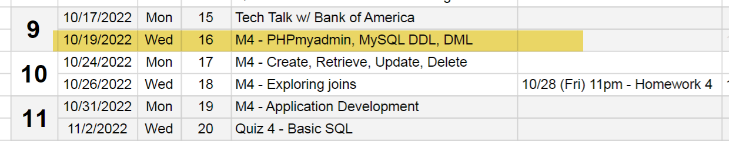
Housekeeping
Quiz 3 – review answers, updates on grades
Big CHANGES in Schedule and Outline
See new due dates and deadlines
Homework due NEXT WEEK Friday, 10/28
Homework not posted yet: developing autograder for Gradescope

Slide 4
Accessing the DBMS

Slide 5
Accessing the DBMS
Using PHPMyAdmin – through a web browser
To manage, monitor and tune the overall system
Using the command line – SSH into server
To script creation and population of the databases
Using a PHP full stack
To run the application and use the database
LAMP – Linux : Apache : MySQL : PHP/Perl/Python
Using NodeJS full stack
To run the application and use the data base
MEAN – Mongo/MySQL : Express : Angular : Node
MERN – Mondo/MySQL : Express : React : Node

Slide 6

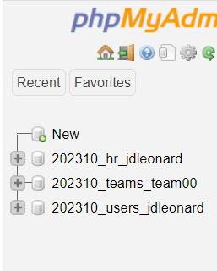
PHPMyAdmin
https://www.cmsc508.com/phpMyAdmin/
Username: your VCUeID (e.g. jl66)
Password: Shout4_jl66_GOME
There are three databases for each user:
202310_hr_jl66 -> for learning and homeworks
202310_users_jl66 -> for play
202310_teams_team00 -> for semester project (this is shared with other team members!)

Slide 7
SSH directly into server
>> ssh jdleonard@cmsc508.com –p 7822
Password: your VID
For example: V00758588
(need to use alternate port number)
>> mysql –p Enter password: Shout4_jdleonard_GOME

Slide 8
Using the PHP full stack
Point your browser at your ~ account
http://cmsc508.com/~jdleonard/
http://cmsc508.com/~jdleonard/bootstrap.php
Source files are located in your home:
/home/202310/jdleonard/public_html
Edit using VSCODE and GITHUB, then RSYNC them to the desired location
Semester project:
/home/202310/team00/public_html
PHP 8 + MySQL + JavaScript + jQuery + Bootstrap + other libraries

Slide 9
Node, React, NextJS and MySQL
Hah! This option is WAY trickier and more difficult to mass-produce for the entire class. I tried – and while I can run individual servers, crafting one for everyone will require more than a weekend to pull off!
I will work with you if you are feeling way bold!
https://www.youtube.com/watch?v=aprLiG34b50
https://github.com/FaztWeb/nextjs-mysql-crud

Slide 10
… In Previous episodes …
CMSC 508 – Database Theory

Slide 11
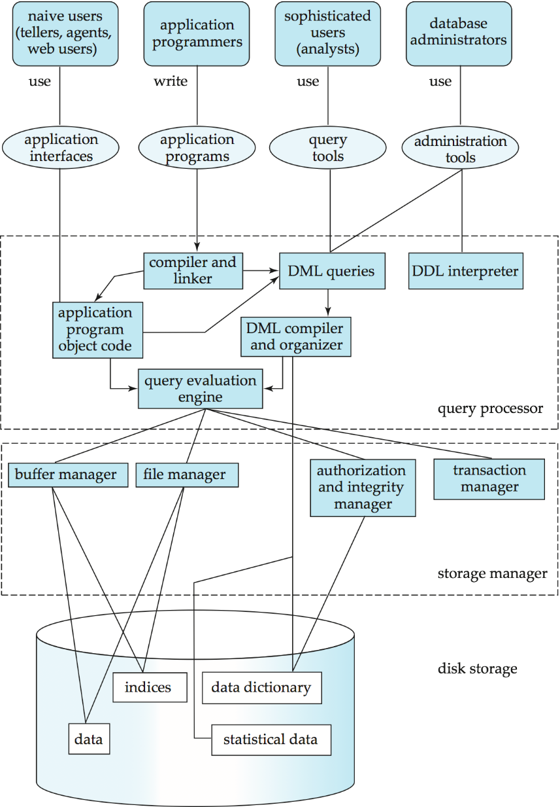
Leveraging the DBMS
What not simply use 2-D arrays or other data structures in our programs? Why use a data base at all?
The DBMS will DO LOTS OF WORK for us AUTOMATICALLY.
We simply need to know how to tell it what we want it to do.
We can provide these management and operating rules when tables are created.
The DBMS will enforce the rules in real-time behind the scenes.
Notes:
An overview of the complexity of a DBMS. This is a general view. A DBMS can take different forms, such as…

Slide 12
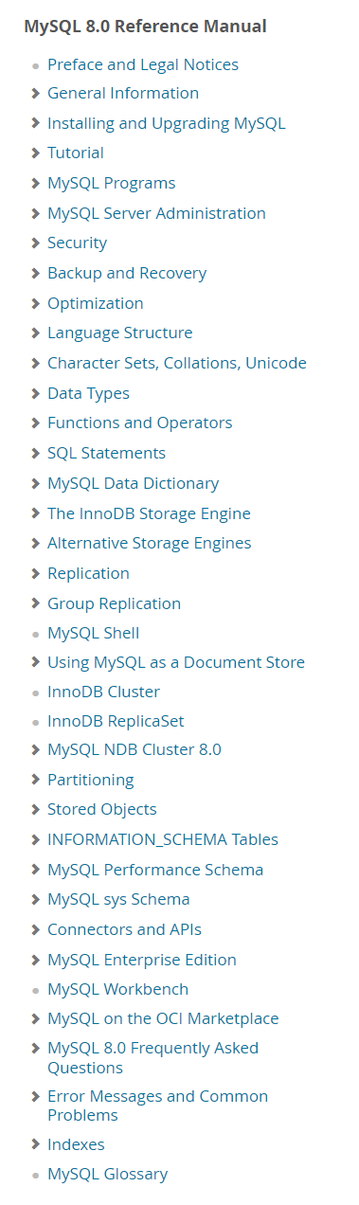
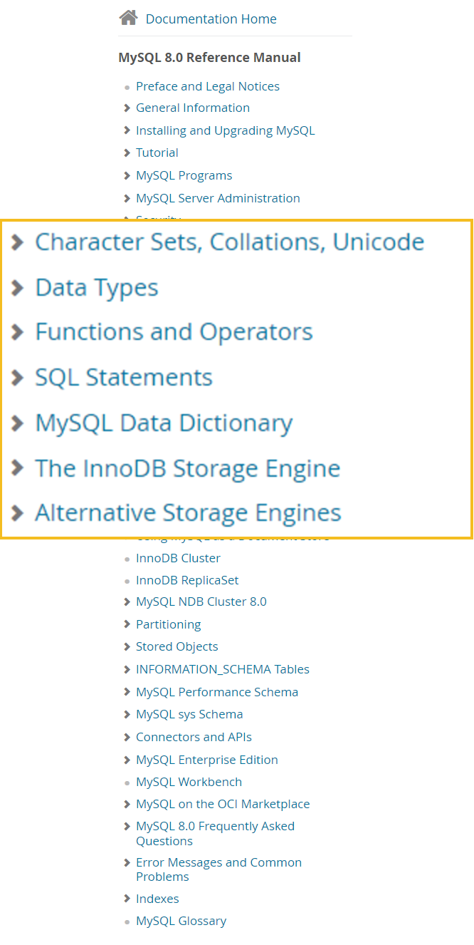
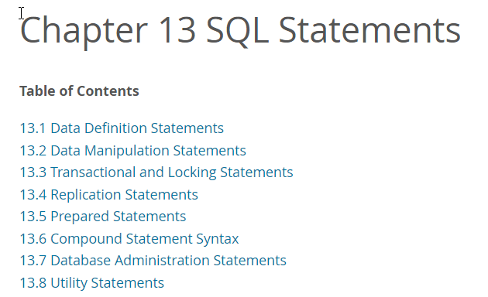

MySQL 8.0 Documentation
https://dev.mysql.com/doc/refman/8.0/en/

Slide 13
Data Definition Language

Slide 14

CMSC 508 – Databases
Introduction to SQL
Data Definition Language
The SQL data definition language (DDL) allows the specification of information about relations, including:
The schema for each relation
The domain of values associated with each attribute
Integrity constraints
Other information such as:
The set of indices to be maintained for each relation
Security and authorization information for each relation
The physical storage structure of each relation on disk

Slide 15
Data Definition Statements
13.1.2 ALTER DATABASE 13.1.3 ALTER EVENT 13.1.4 ALTER FUNCTION 13.1.5 ALTER INSTANCE 13.1.6 ALTER LOGFILE GROUP 13.1.7 ALTER PROCEDURE 13.1.8 ALTER SERVER 13.1.9 ALTER TABLE 13.1.10 ALTER TABLESPACE 13.1.11 ALTER VIEW | 13.1.12 CREATE DATABASE 13.1.13 CREATE EVENT 13.1.14 CREATE FUNCTION 13.1.15 CREATE INDEX 13.1.16 CREATE LOGFILE GROUP 13.1.17 CREATE PROCEDURE and CREATE FUNCTIONs 13.1.18 CREATE SERVER 13.1.19 CREATE SPATIAL REFERENCE SYSTEM 13.1.20 CREATE TABLE 13.1.21 CREATE TABLESPACE 13.1.22 CREATE TRIGGER 13.1.23 CREATE VIEW | 13.1.24 DROP DATABASE 13.1.25 DROP EVENT 13.1.26 DROP FUNCTION 13.1.27 DROP INDEX 13.1.28 DROP LOGFILE GROUP 13.1.29 DROP PROCEDURE and DROP FUNCTIONs 13.1.30 DROP SERVER 13.1.31 DROP SPATIAL REFERENCE SYSTEM 13.1.32 DROP TABLE 13.1.33 DROP TABLESPACE 13.1.34 DROP TRIGGER 13.1.35 DROP VIEW 13.1.36 RENAME TABLE 13.1.37 TRUNCATE TABLE

Slide 16
Data manipulation languaGE

Slide 17
Data Manipulation Statements
13.2.1 CALL Statement 13.2.2 DELETE Statement 13.2.3 DO Statement 13.2.4 HANDLER Statement 13.2.5 IMPORT TABLE Statement 13.2.6 INSERT Statement 13.2.7 LOAD DATA Statement 13.2.8 LOAD XML Statement 13.2.9 REPLACE Statement | 13.2.10 SELECT Statement 13.2.11 Subqueries 13.2.12 TABLE Statement 13.2.13 UPDATE Statement 13.2.14 VALUES Statement 13.2.15 WITH (Common Table Expressions)

Slide 18
The HR database

Slide 19
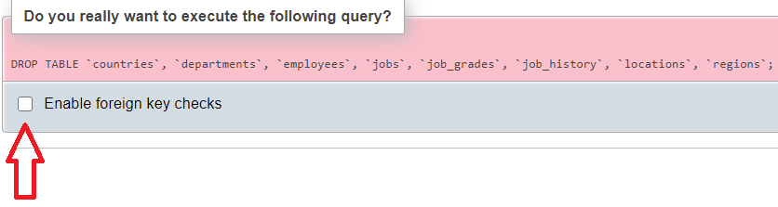
CMSC 508 – Databases
Introduction to SQL
Human Resources Database
DO NOT make permanent changes to the tables of the database. If you do, the results of the queries for the exercises may change.
If you need to rebuild the original database:
Drop the current content (procedures, views, tables (in that order) and make sure to untick “Enable foreign key checks”
Rebuild the original content using this script. Go to the “Import” tab, select the .sql file and import the data.
Finally, refresh the panel on the left and you will see the tables recreated

Slide 20
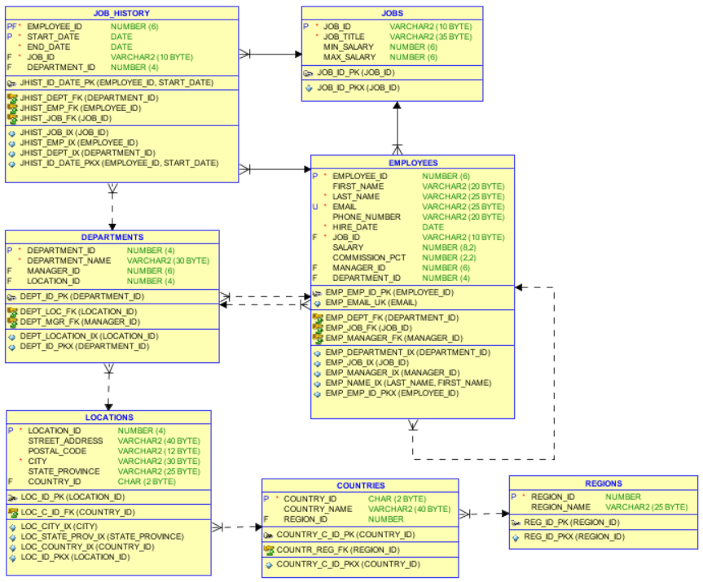

CMSC 508 – Databases
Introduction to SQL
Human Resources Database

Slide 21
Building a DB – work flow

Slide 22
Building a database – work flows
Building initial database (usually scripted)
Create table
Insert rows
Define indexes
Manage data base (scripts or web apps)
Insert rows
Delete rows
Update rows
Run reports (queries)

Slide 23
Data types

Slide 24
CMSC 508 – Databases
Introduction to SQL
Data types (MySQL)
CHAR(size)
The length of a CHAR column is fixed to the length that you declare when you create the table. The length can be any value from 0 to 255.
VARCHAR(size)
Values in VARCHAR columns are variable-length strings. The length can be specified as a value from 0 to 65535.
String | CHAR(4) | Storage Required | VARCHAR(4) | Storage Required
'' | ' ' | 4 bytes | '' | 1 byte
'ab' | 'ab ' | 4 bytes | 'ab' | 3 bytes
'abcd' | 'abcd' | 4 bytes | 'abcd' | 5 bytes
'abcdefgh' | 'abcd' | 4 bytes | 'abcd' | 5 bytes

Slide 25
CMSC 508 – Databases
Introduction to SQL
Data types (MySQL)
Integer: INT, SMALLINT, TINYINT, MEDIUMINT, BIGINT
Floating-point: DECIMAL/NUMERIC, FLOAT, DOUBLE
NUMERIC(precision, scale) e.g. NUMERIC(5,2) ranges -999.9 to 999.99
FLOAT 32-bit - DOUBLE 64-bit
Type | Storage (Bytes) | Minimum Value Signed | Minimum Value Unsigned | Maximum Value Signed | Maximum Value Unsigned
TINYINT | 1 | -128 | 0 | 127 | 255
SMALLINT | 2 | -32768 | 0 | 32767 | 65535
MEDIUMINT | 3 | -8388608 | 0 | 8388607 | 16777215
INT | 4 | -2147483648 | 0 | 2147483647 | 4294967295
BIGINT | 8 | -2⁶³ | 0 | 2⁶³-1 | 2⁶⁴-1

Slide 26
CMSC 508 – Databases
Introduction to SQL
Data types (MySQL)
Date and Time: DATE, DATETIME, TIMESTAMP, TIME, YEAR
DATE is used for dates in 'YYYY-MM-DD' format
DATETIME is used for dates and time in 'YYYY-MM-DD hh:mm:ss' format. The supported range is '1000-01-01 00:00:00' to '9999-12-31 23:59:59’.
TIMESTAMP is used for dates and time in 'YYYY-MM-DD hh:mm:ss' format. Has a range of '1970-01-01 00:00:01' UTC to '2038-01-19 03:14:07' UTC. Self-updates when rows are edited.
TIME in 'hh:mm:ss' format
YEAR in 'YYYY' format
Data Type | “Zero” Value
DATE | '0000-00-00'
TIME | '00:00:00'
DATETIME | '0000-00-00 00:00:00'
TIMESTAMP | '0000-00-00 00:00:00'
YEAR | 0000

Slide 27
CMSC 508 – Databases
Introduction to SQL
Data types (MySQL)
BLOB
A BLOB is a binary large object that can hold a variable amount of data. The four BLOB types are TINYBLOB, BLOB, MEDIUMBLOB, and LONGBLOB. These differ only in the maximum length of the values they can hold.
TEXT
TEXT values are treated as nonbinary strings (character strings). The four TEXT types are TINYTEXT, TEXT, MEDIUMTEXT, and LONGTEXT.
It’s not recommended to unnecessarily increase the database with huge items. Preferred to externalize content and reference using a link (e.g. path to file)

Slide 28
Creating tables

Slide 29
CMSC 508 – Databases
Introduction to SQL
CREATE TABLE
A SQL relation is defined using the CREATE TABLE command:
CREATE TABLE relation (C₁ D₁, C₂ D₂, ..., C_{n} D_{n}, (integrity-constraint₁), ..., (integrity-constraint_{k}))
relation is the name of the table
C_{i} is the i-th column name
D_{i} is the data type of values in the domain of column C_{i}
Constraints
AUTO_INCREMENT
NOT NULL
UNIQUE
CHECK (predicate)
PRIMARY KEY (Cn, ..., Cm )
FOREIGN KEY (Cj, ..., Ck ) REFERENCES relation([Cq, ..., Cw ])
*Referenced foreign keys must be on an indexed attribute
Main data types
CHAR(size)
VARCHAR(size)
INT
FLOAT
DECIMAL(P,S)
DATE
DATETIME
TIMESTAMP

Slide 30
CMSC 508 – Databases
Introduction to SQL
CREATE TABLE (MySQL Reference Manual)
CREATE TABLE instructor (
ID int AUTO_INCREMENT,
name varchar(20) NOT NULL,
dept_name varchar(30),
salary decimal(10,2) CHECK (salary > 0),
office char(5) NOT NULL UNIQUE,
PRIMARY KEY (ID),
FOREIGN KEY (dept_name) REFERENCES departments (department_name)
);

Slide 31
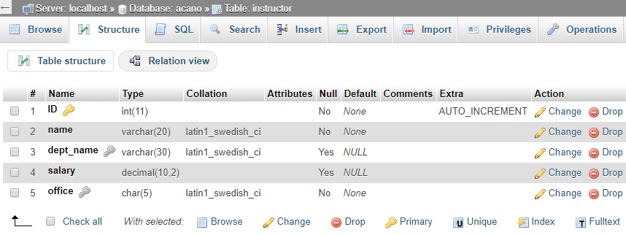
CMSC 508 – Databases
Introduction to SQL
ALTER TABLE (MySQL Reference Manual)
ALTER TABLE instructor ADD foocolumn VARCHAR(25);
ALTER TABLE instructor DROP COLUMN foocolumn;
phpMyAdmin GUI: Structure tab

Slide 32
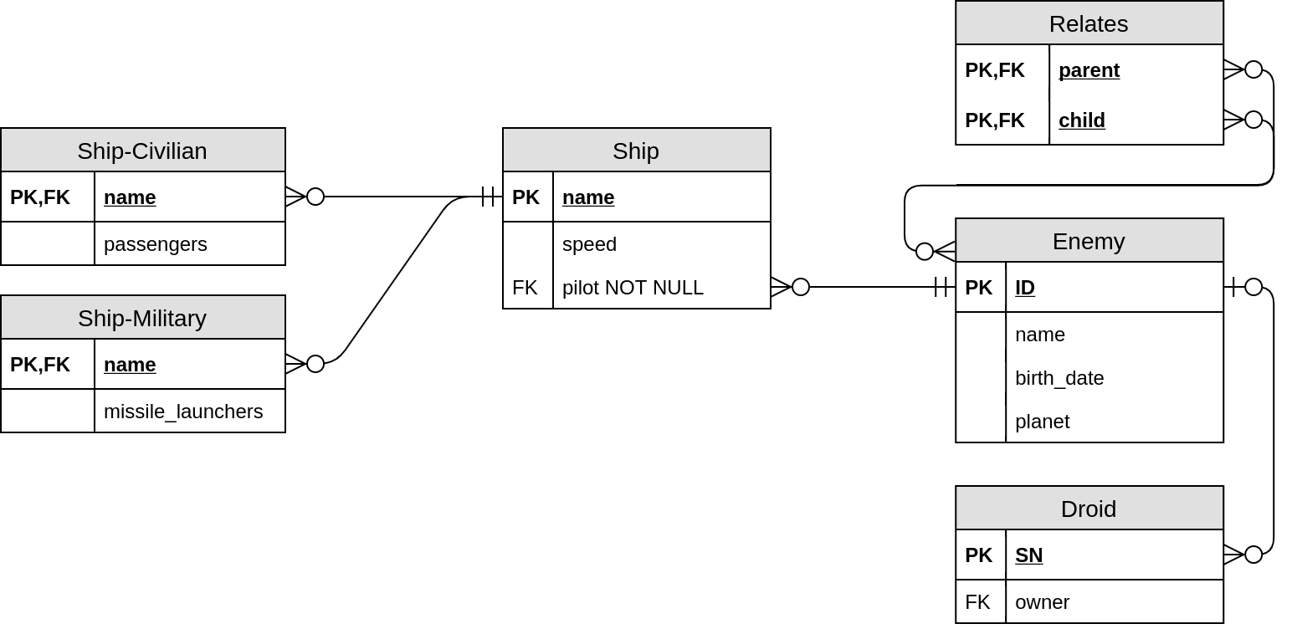
CMSC 508 – Databases
Introduction to SQL
Remember the Star Wars relational diagram?

Slide 33
CMSC 508 – Databases
Introduction to SQL
Star Wars SQL syntax
CREATE TABLE enemy ( ID char(5), name varchar(255), birth_date date, planet varchar(255), PRIMARY KEY (ID));
CREATE TABLE relates ( parent char(5), child char(5), PRIMARY KEY (parent, child),
FOREIGN KEY (parent) REFERENCES enemy (ID),
FOREIGN KEY (child) REFERENCES enemy (ID));

Slide 34
CMSC 508 – Databases
Introduction to SQL
Star Wars SQL syntax
CREATE TABLE droid ( SN char(32), owner char(5), PRIMARY KEY (SN),
FOREIGN KEY (owner) REFERENCES enemy (ID));
CREATE TABLE ship ( name varchar(255), speed float,
pilot char(5) NOT NULL, PRIMARY KEY (name),
FOREIGN KEY (pilot)
REFERENCES enemy (ID));
CREATE TABLE ship-civilian ( name varchar(255), passengers int, PRIMARY KEY (name),
FOREIGN KEY (name) REFERENCES ship (name));
* Similar to ship-military

Slide 35
Insert, update and delete

Slide 36
CMSC 508 – Databases
Introduction to SQL
INSERT (MySQL Reference Manual)
INSERT INTO relation VALUES (V₁, …, V_{N});
Inserts a new row with all the values matching the order of the columns. DO NOT USE.
INSERT INTO instructor VALUES (123, 'ALBERTO CANO', NULL, 1234.56, 'E4251');
INSERT INTO relation (C_{i}, …, C_{j}) VALUES (V_{i}, …, V_{j});
Inserts a new row with the values matching any order of the columns specified, any other column not listed is assumed to be NULL.
INSERT INTO instructor (ID, name, salary, office)
VALUES (123, 'ALBERTO CANO', 1234.56, 'E4251');
INSERT INTO instructor (name, salary, office)
VALUES ('ALBERTO CANO', 9876.5, 'W0465'); -- ID AUTO GENERATED

Slide 37
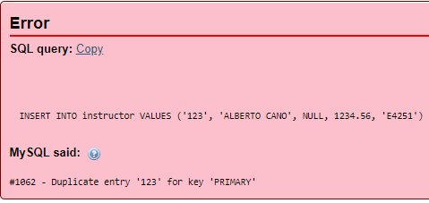
CMSC 508 – Databases
Introduction to SQL
Understanding MySQL errors
If we execute both instructions, the first will be valid inserting the new instructor with ID 123. However, the second will fail because we attempt to insert another row with the same value for the PRIMARY KEY (ID).
INSERT INTO instructor VALUES (123, 'ALBERTO CANO', NULL, 1234.56, 'E4251');
INSERT INTO instructor (ID, name, salary, office)
VALUES (123, 'ALBERTO CANO', 1234.56, 'E4251');

Slide 38
CMSC 508 – Databases
Introduction to SQL
UPDATE (MySQL Reference Manual)
UPDATE relation SET C_{i} = V_{i} , C_{j} = V_{j} , … [WHERE predicate];
Updates the content of a table, modifying the columns specified with the provided values for the rows satisfying the predicate.
UPDATE instructor SET salary = 4321.00 WHERE ID = 123;
CORRECT. Will update the salary based on the PRIMARY KEY.
UPDATE instructor SET salary = 4321.00 WHERE name = 'ALBERTO CANO';
INCORRECT. Will update the salary for ALL instructors with the given name.
UPDATE instructor SET salary = 4321.00;
INCORRECT. Will update everyone’s salary!
UPDATE instructor SET salary = salary * 1.05;
Will update everyone’s salary +5% respectively.

Slide 39
CMSC 508 – Databases
Introduction to SQL
UPDATE (MySQL Reference Manual)
UPDATE instructor
SET salary = CASE
WHEN salary <= 100000 THEN salary * 1.05
ELSE salary * 1.03
END;
Updates every salary based on SWITCH CASE
UPDATE instructor SET dept_name = 'CS' WHERE ID = 123;
#1452 - Cannot add or update a child row: a foreign key constraint fails (`acano`.`instructor`, CONSTRAINT `instructor_ibfk_1` FOREIGN KEY (`dept_name`) REFERENCES `departments` (`department_name`))
Foreign key violation! there's no 'CS' department in the departments table.
Update command canceled.

Slide 40
CMSC 508 – Databases
Introduction to SQL
DELETE (MySQL Reference Manual)
DELETE FROM relation [WHERE predicate];
Removes from a table the rows satisfying the condition of the predicate.
DELETE FROM instructor;
Removes every row from the instructor table. Are you sure about that?
DELETE FROM instructor WHERE ID = 123;
CORRECT. Removes the row where the PRIMARY KEY (ID) is 123.
DELETE FROM instructor WHERE name = 'ALBERTO CANO';
INCORRECT. Removes all rows for instructors with a given name.
DELETE FROM instructor; [PANIC]
If you know some Spanish, there’s even a musical video to honor those who forget the WHERE clause in a DELETE statement on production systems.

Slide 41

CMSC 508 – Databases
Introduction to SQL
DELETE (MySQL Reference Manual)
What happens if you try to delete a row for which there’s an existing foreign key?
DELETE FROM employees WHERE employee_id = 100;
#1451 - Cannot delete or update a parent row: a foreign key constraint fails (`acano`.`departments`, CONSTRAINT `dept_mgr_fk` FOREIGN KEY (`manager_id`) REFERENCES `employees` (`employee_id`))
You cannot delete a “parent” record if there’s a child dependency -> Foreign key constraints -> Referential integrity

Slide 42
CMSC 508 – Databases
Introduction to SQL
TRUNCATE (MySQL Reference Manual)
DROP TABLE (MySQL Reference Manual)
TRUNCATE TABLE relation;
Removes all rows in a table and resets metadata (counters, indexes, etc)
DROP TABLE relation;
Removes the table from the database.
DROP TABLE instructor;
DELETE = Removes rows satisfying conditions
TRUNCATE = Removes all rows in a table and resets metadata (e.g. auto increment)
DROP TABLE = Deletes the whole table from the database

